Slide 1

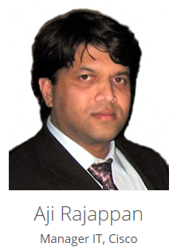
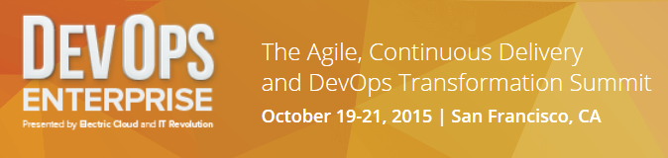
Continuous Delivery at Cisco IT
Large-scale, Enterprise-wide Delivery Transformation

Slide 2

Agenda
Our approach and implementation
What results did we see
‘Stickies’ for a successful CD transformation
Focus of Continuous Delivery at Cisco
We need help in these areas
Continuous Delivery Transformation

Slide 3



Continuous Delivery Transformation Accelerating the speed of business with Fast IT
Accelerate
Time-to-Capability
Improve Software Quality
Optimize
Cost-of-Delivery
Small & Mighty Teams
Active Stakeholders
Iterative Approach
Testing Automation
Embed SMEs
Fail Fast / Recover
Dedicated Teams
Adaptive Infrastructure
Self-Service Tools
Change the
Culture
Mindset
Perception
of IT

Slide 4
Changing the Way We Work: Continuous Delivery
Plan
Iterative Planning
Develop and Build
Continuous Integration
Automated Testing
Built by Developers
Embedded QC
Deploy & Release
Control Gates
Regulatory Compliance
Adapt & Scale
Policy Enforced Workload Mobility
Innovation Circles
Architectural Framework
Active Stakeholders
Small & Mighty Teams
Automation Tools
Embedded SMEs
Automation Tools
Centralized Test Data Management
Automation Tools
Centralized Release Management
Active Stakeholders
Fast Results
Operational Priority
High Availability
Mindset

Slide 5


Continuous Delivery Core Team
Program
Director
Chief
Architect
Sustainability
PMO
Operations
Automation
Evolution Plan
Org Change
End State Model
Business Value Case
Communication
Change Management
Program Governance
Metrics
CD Core Team
Process
Adoption
End to End Process
Biz Engagement
Best Practices
Training
Release Strategy
Adoption Plan
Client Engagement
Best Practices
Checkpoints
Certification
Tools
Tool Chain
Automation
Optimization
Release Environment
Technical Support

Slide 6


Adoption/Subscriber “Waves” (80+ Services & 600+ Applications grouped into 3 waves)
Willing partner
Get a “win”
Create your ambassador network
Pioneer
Wave 1
Prove it’s scalable
Take a risk
Show business value
Business Critical
Wave 2
Finish the job
Everyone gets to go
Make it “concrete”
All Others
Wave 3

Slide 7
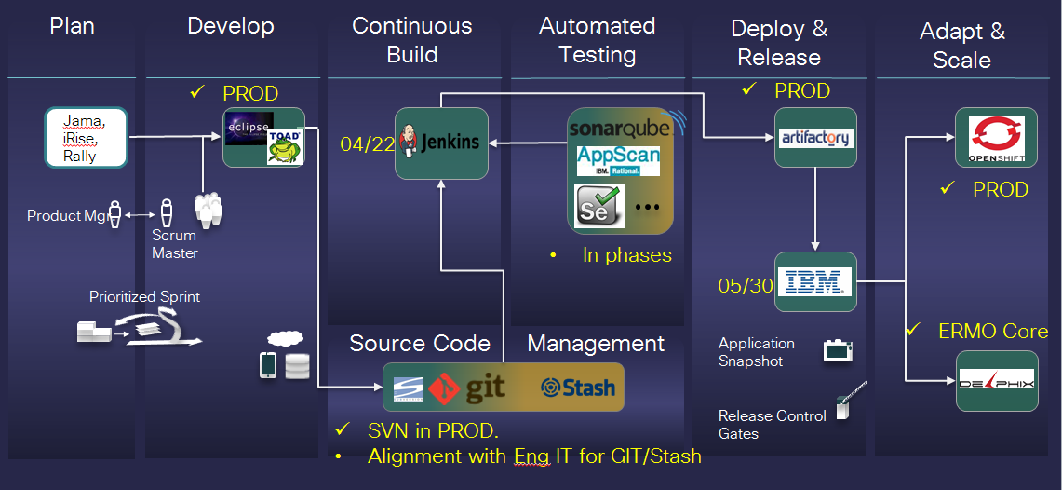
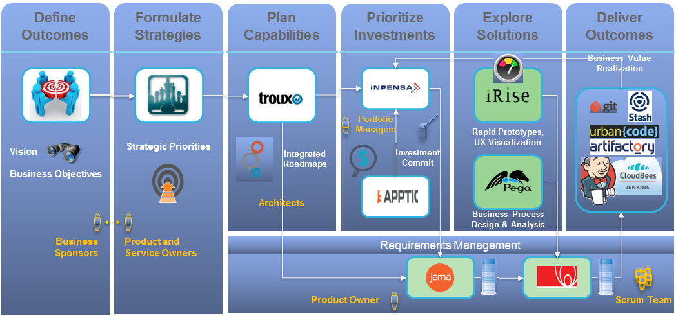
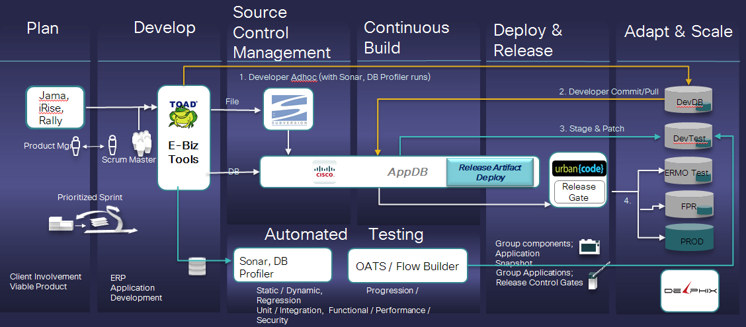
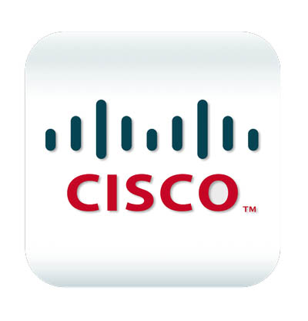
E2E Tools Landscape
Non-ERP
Portfolio & Business Outcome
ERP
AppDB
A tool developed Internally in Cisco IT
for Oracle Code Deployment

Slide 8
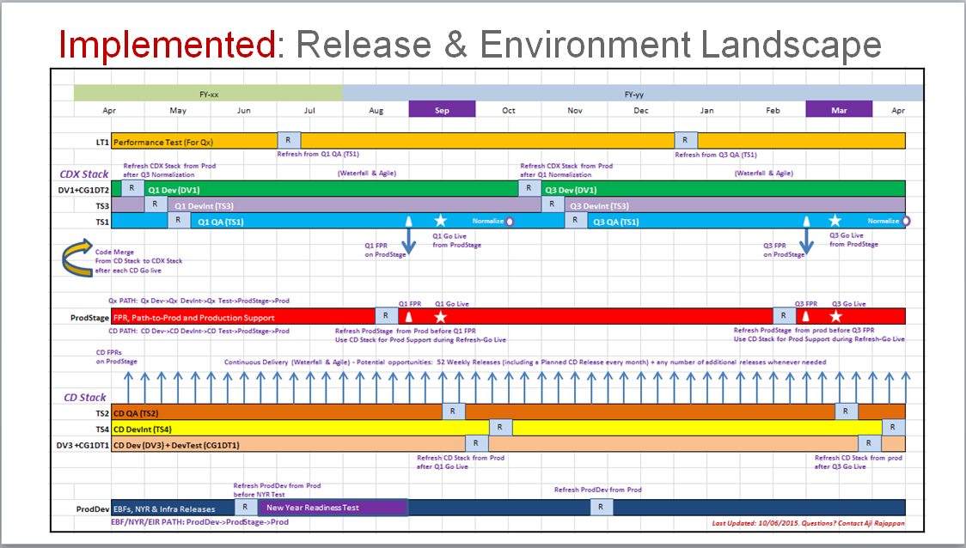
Conceptual: Release & Environment Model
3 Lanes together provide unlimited go live opportunities
All lanes merge in Stage
before deployment to Prod
Medium Frequency Lane
Large Scope
Every Six Months
Dev
DevInt
QA
1
High Frequency Lane
Medium Scope: Every Month
Small Scope: Every Week/Day
Dev
DevInt
QA
2
Stage
Prod
Dev
Emergency Lane
Bug Fixes & Patches
On Demand
3

Slide 9
How did we measure?
# of Enhancements or # Stories Delivered
Speed
How fast?
TC / # Enhancements or # Stories Delivered
Cost
At what price?
Incidents & Downtime
Quality
With what quality?
Process & Platform Adoption
Adoption
How transformational?
Business Value
Biz Value
Got measurable value?

Slide 10
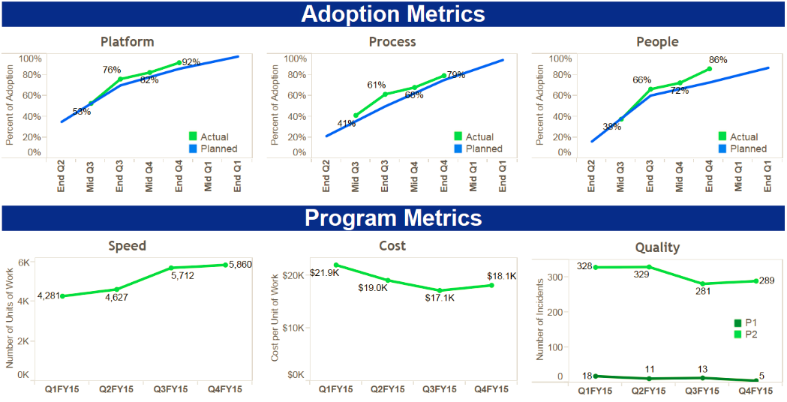
Continuous Delivery Scorecard

Slide 11
Methodology adoption (Waterfall vs Agile)

Slide 12
Application Delivery Productivity Savings Opportunity
Plan
Develop & Build
Regression
Test
Deploy
Progression
Test
11.25%
6.00%
7.50%
4.75%
2.50%
Total Savings
32.00%

Slide 13
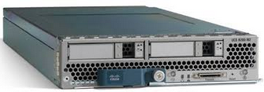
We need help in these areas
Copy/Clone
ERP/Oracle Environment refresh in 2 days (we have reduced it from 10 days to 6 days)
Coexistence of multiple active versions of code (FE/BE) in the same environment
Team 1 for Release A
Team 2 for Release B (overlaps with Rel A)

Slide 14

‘Stickies’ for a successful Continuous Delivery Transformation
Platform
Release
Test
Virtualization
Expedited full-stack provisioning
Elastic infrastructure
Faster Env refreshes
Simplified Infra Engagement
Go Live windows
Simplified Process
Release Types
Release & Env Model
Freeze process
Early engagement
E2E Automation
Test Automation
Risk Based Testing
Test Data Management
Performance Test
Program
PMO
Process
Tools
Adoption
Metrics
Ambassadors
Compliance
Tools
Development
Security
SOX
ISO
Tools for ERP and non-ERP
Integrated CD Tool set
Connected Collab tools
PLC (Agile/Hybrid)
Estimation
Code Merge
Embedded QA
Built-in Compliance
Training
Scrum Master Training
Product Owner Training
SAFe Training
Applied Agile Training
Hands-on Workshops
Process
End to End Process
Best Practices (CoE)
Release Process
Business Engagement
Requirement Process
Dev Processes
Test Process
Deployment Process
Production Support Process
Env Support Process
Compliance Process
Generic
Transactional vs Content Based
X-functional vs standalone
MVP vs WBS/Components
Distributed vs Collocated
Definition & Measure of Speed
Deployment Frequency
Agile Team Workspaces
Vendor Readiness & SOWs
Support
P1 support for Platform & Tool
Click-to-chat
Self-service Portal
Client Experience

Slide 15

CRC update to consistent look and feel
A

